Slide 1
Making the Case for an Arts Degree
Sally Gaskill, Director, SNAAP
Indiana University Bloomington
ICFAD October 7, 2016

Slide 2
Today’s burning questions.
Do enrollment trends keep you up at night?
What do you tell prospective parents & students about their job prospects in the arts?
Notes:
How do you fight the public perception of what it is to be an artist?

Slide 3
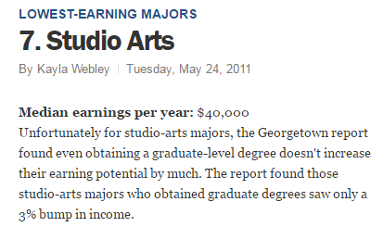
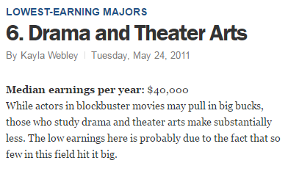
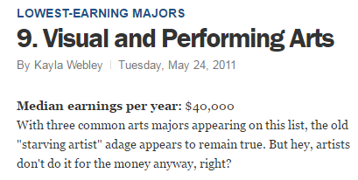
It’s not easy.
Notes:
TIME MAGAZINE- 2011

Slide 4
Notes:
FORBES – 2012
Forbes: Worst College Majors (as determined by Census data):
Top 8 include 4 arts majors: “Film, video, photography; Fine arts; Music; Commercial art & graphic design”

Slide 5
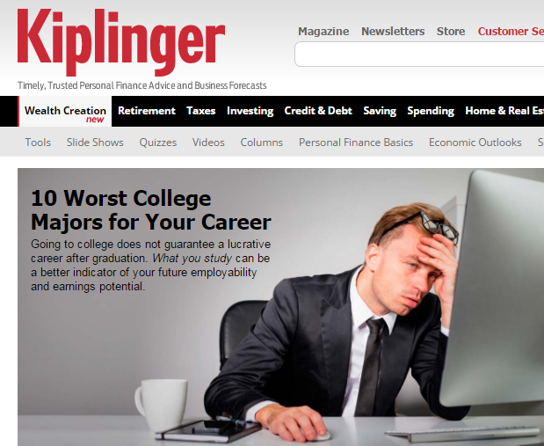
Notes:
The rankings persist. Last week – this was the Kiplinger home page.

Slide 6
Notes:
KIPLINGER 2015-16

Slide 7
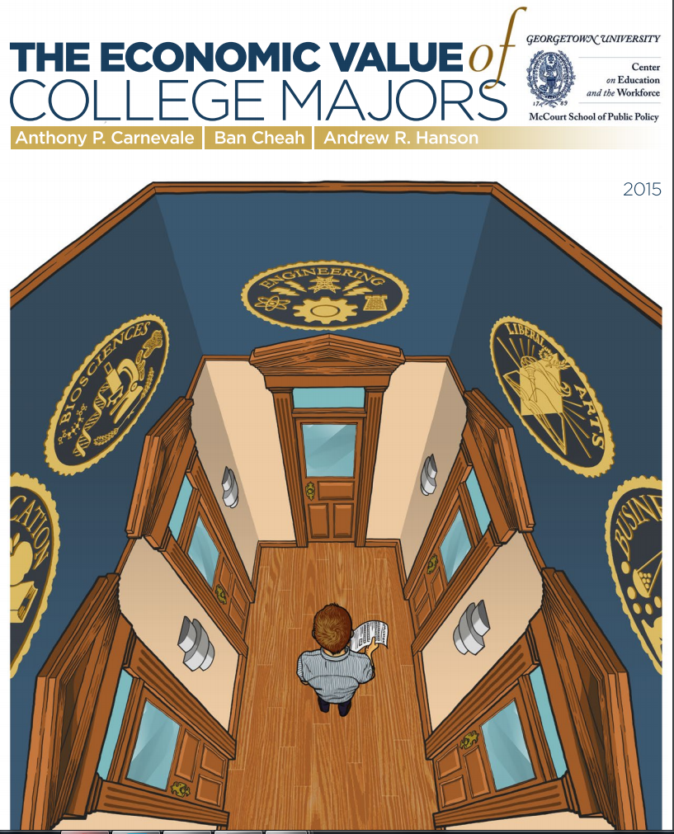
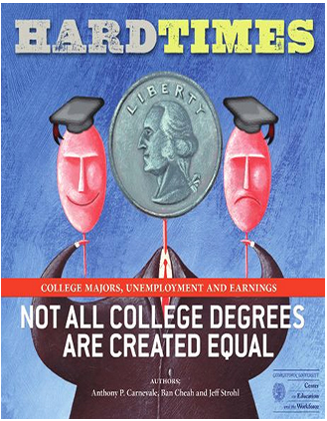
Notes:
These articles are based on data from the Georgetown University Center on Education and the Workforce
They use census data to look at how much money people make based on their college degrees. They don’t look at satisfaction, or how creative you get to be, or anything else -
the value of a major is ALL about how much money you make.

Slide 8
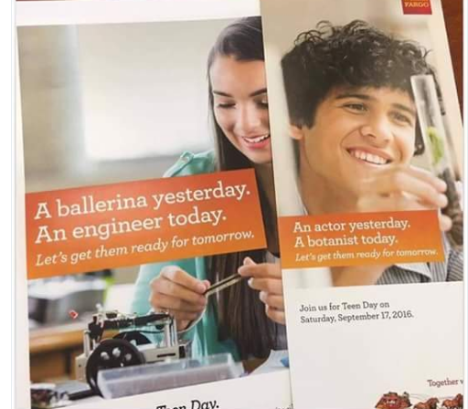
Notes:
Another example of negative perspective - from a recent Wells Fargo Bank campaign (September 2016)

Slide 9
Enrollment trends
Notes:
National Center for Education Statistics – US Department of Education
Beginning in 2003, the number of arts graduates has increased steadily. From about 108,000 arts degrees per year up to 140,000.

Slide 10
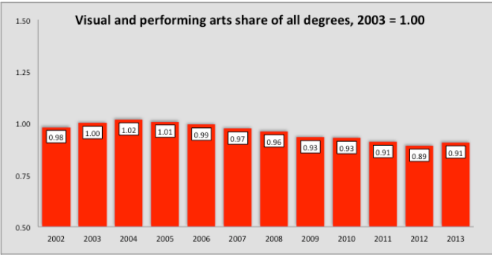
Notes:
However – the percentage of arts degrees compared to all college degrees over the same period has gone down.
These are the same data, but using the % of arts degrees given, compared to all degrees. Here, the peak percentage year was 2004 (4.3%) then it went down, with a slight uptick in 2013 (3.8%).

Slide 11
So, what’s an Associate Dean
for the Arts to do?

Slide 12
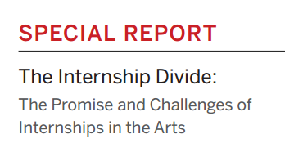
Notes:
SNAAP has been collecting and analyzing data since 2008. We are not an advocacy organization, but many of our research findings– about the lives & careers of arts graduates - are positive.
These are the titles of some of the reports we have published over the last 5 years.
We also release DataBriefs every throughout the year, with nuggets of useful data.

Slide 13
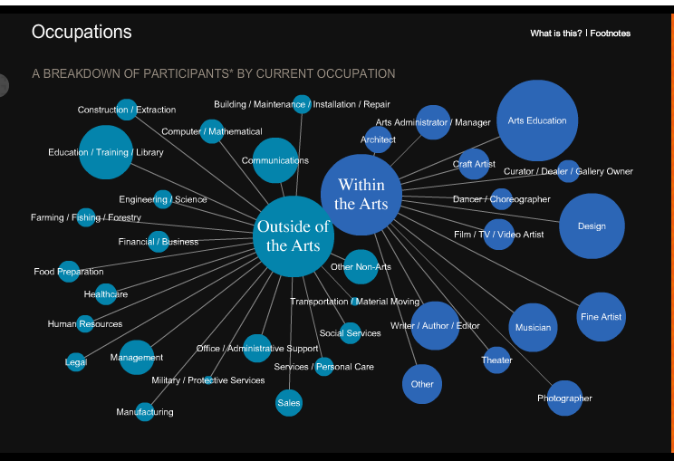
Notes:
Occupations of arts alumni – page from the SnaapShot.
snaap.indiana.edu/snaapshot

Slide 14
https://www.youtube.com/watch?v=XGgCEnsCR_s
Notes:
Uncle Henry began as an article that Steven Tepper published around Commencement time in 2011 in the Huffington Post. Five years later, his team at ASU turned it into this, and it was released at our 3 Million Stories conference in March 2016.

Slide 15
Satisfaction with education
90% say their overall arts education experience was “good” or “excellent”
87% who make <$20K/year
79% who are unemployed and looking for work
84% would recommend their school to others
Notes:
Recap of some of the data in Uncle Henry

Slide 16
Unemployment rate
Arts graduates’ unemployment rate is less than the general population’s
(5% in Fall 2015)
It’s 3% -- the same as all other college graduates

Slide 17
Work in a field related to their degree
74% of arts alumni who intended to become professional artists have done so at some point in their career
Compared to …
58% of biology majors
56% of accounting majors
53% of mechanical engineering majors

Slide 18
Job satisfaction.
Arts alumni have some of the highest levels of job satisfaction in all occupations
Wages lag behind – but research shows that higher wages alone have minimal impact on general happiness
General Social Survey (GSS)
+ Several other happiness studies

Slide 19
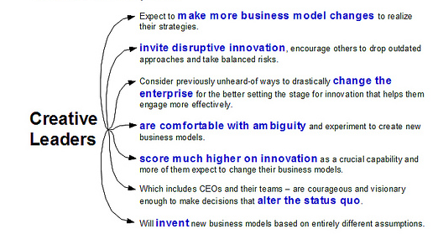
IBM Global CEO Study
The #1 skill desired in an employee is creativity
Notes:
In surveying more than 1500 CEOs from around the world, the IBM 2010 Global CEO Study found that CEOs believe successfully navigating an increasing complex world will require creativity.

Slide 20
Entrepreneurship
Fewer than 5% of Americans are self-employed in their own incorporated business
Arts graduates are much more likely to be founders of their own businesses (non-profit + for-profit) –
10% of alumni who graduated in the last 5 years
20% of arts alumni who graduated 1985 and before

Slide 21
Transferrable skills
Top skills learned by arts graduates in school:
Creative thinking & problem solving
Critical thinking and analysis of arguments & information
Improved work based on feedback from others

Slide 22
An artists’ skillset includes …
Improvisation
Expressive agility
Radical revision
Creative collaboration
Flexibility and ambiguity
Empathic reasoning
Imagination and hypothetical thinking
Analogical thinking
Risk & failure (intensive experimentation)
Resilience
Problem finding
Playful exploration

Slide 23
In sum
The vast majority of arts graduates are ..
Gainfully employed
Satisfied with their work
Would go to arts school again if given the choice
Notes:
These are the national data. Bear in mind that if you have your own SNAAP data, you are going to look a lot more credible in the eyes of suspicious parents and anxious students because they’ll be able to see specifically what YOUR school’s outcomes are.

Slide 24
Thank you!
Sally Gaskill
Director, SNAAP
Center for Postsecondary Research, School of Education
Indiana University Bloomington
812-856-5824
gaskill@indiana.edu
snaap.indiana.edu

